Slide 1
Newspaper Generator Project
SCS 3546 Deep Learning - University of Toronto - Summer 2024
by Rojean Noorinayer, Marco Hening-Tallarico, and Matt Athayde

Slide 2
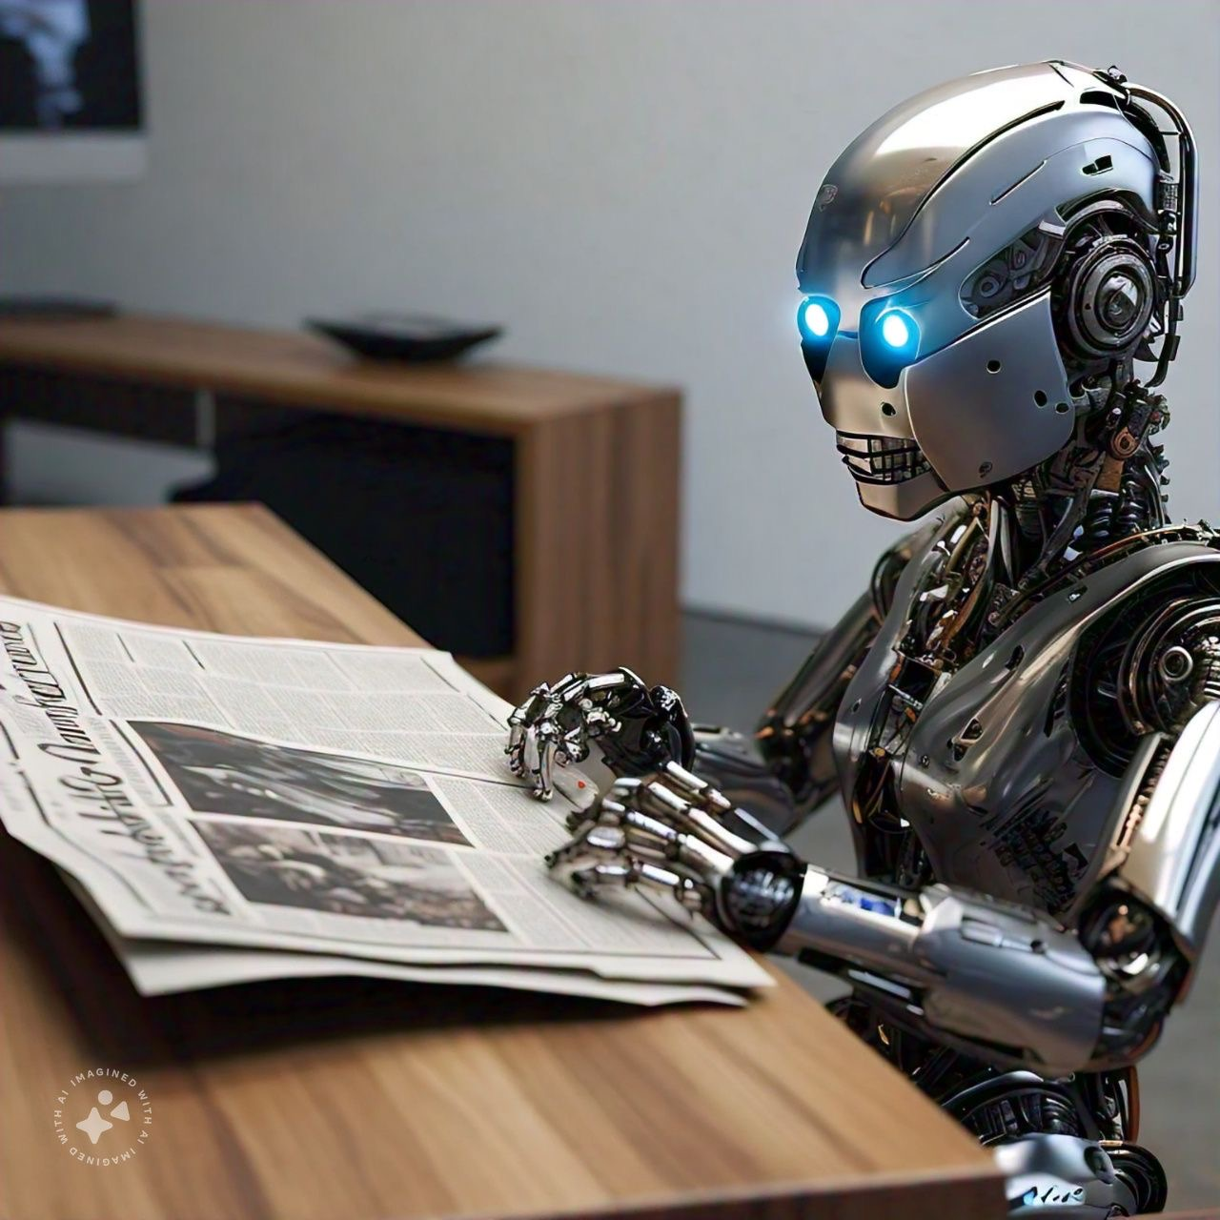
Introduction
Text generation model using a Bidirectional LSTM architecture.
Objective: generating synthetic news articles.
Highlights and Significance
Capability of deep learning techniques like LSTM
Content Creation
Conversational Agents
Data Augmentation

Slide 3
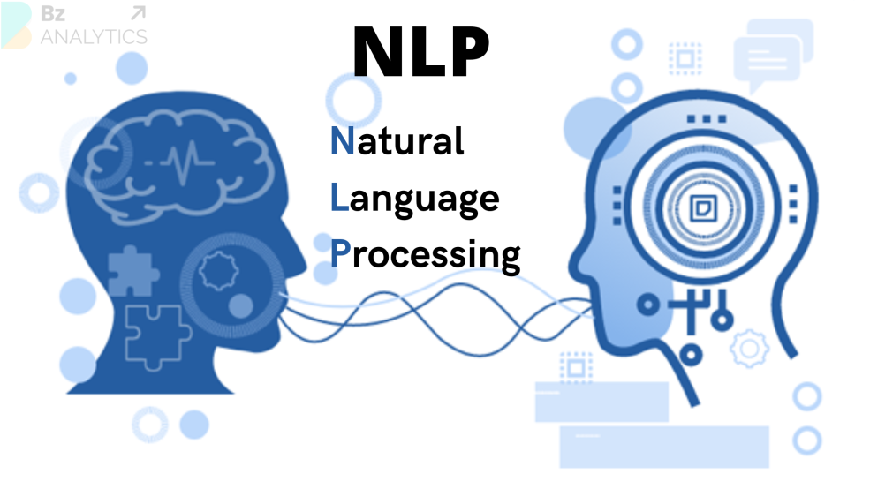
Overview of the Process
Get Data
Explore Data
Data Preprocessing
Build and Train Model
Generate and Test
Notes:
rojean

Slide 4

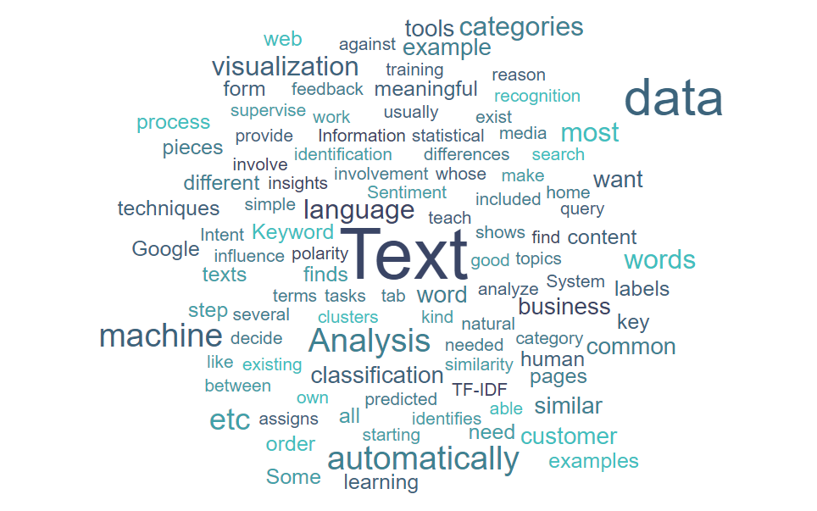
Data Exploration and Preprocessing
Dataset
Kaggle’s BBC news articles dataset
4 columns: category, filename, title, content
5,000 rows
Dataset Characteristics
Diversity: wide range of topics and writing styles.
Relevance: keeping our goal of news generation in mind.
Availability: publicly available.
Data Preprocessing
Reducing numerosity and dimensionality
Data cleaning
Tokenization, sequencing, and padding
Notes:
rojean

Slide 5
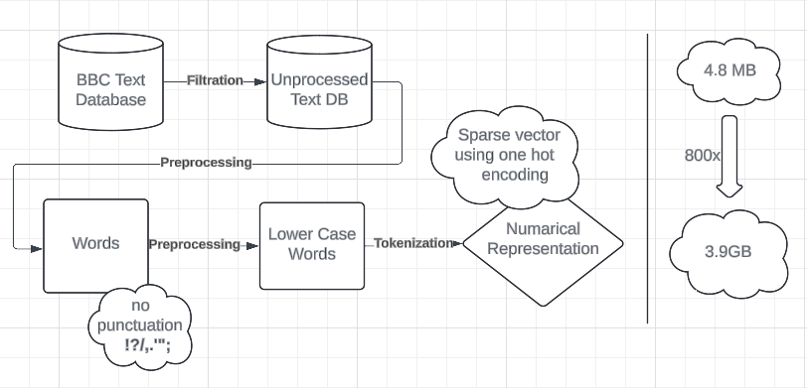
Preprocessing
Notes:
Marco

Slide 6
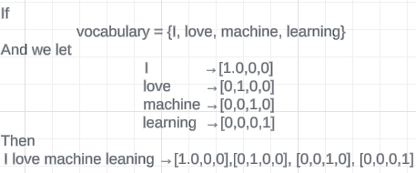
Preprocessing
In practice our vocabulary was 7116 words
Trained on 500 articles
Pro: easy implement and understand
Con: takes up lots of memory
Notes:
Marco

Slide 7
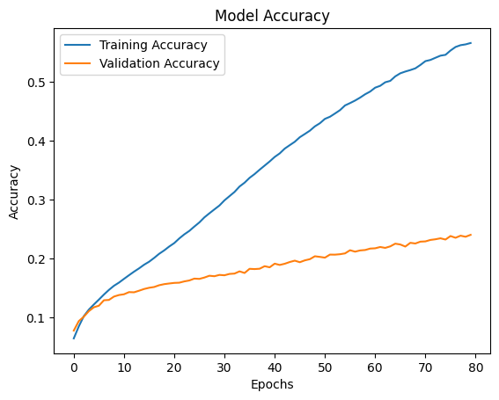
Model Architecture and Performance
A Bidirectional LSTM model.
Good for sequence prediction → remember long-term dependencies.
Bidirectional aspect → learn from both past and future contexts.
Performance:
Validation Accuracy ≈ 0.24
Training Loss: Categorical Crossentropy
Early Stopping condition on validation accuracy
Model utilized ≈ 100GB of RAM to compile
Training time ≈ 4 hours
Fine Tuning
Number of neurons
Dropout rate
Activation function
Notes:
Rojean

Slide 8
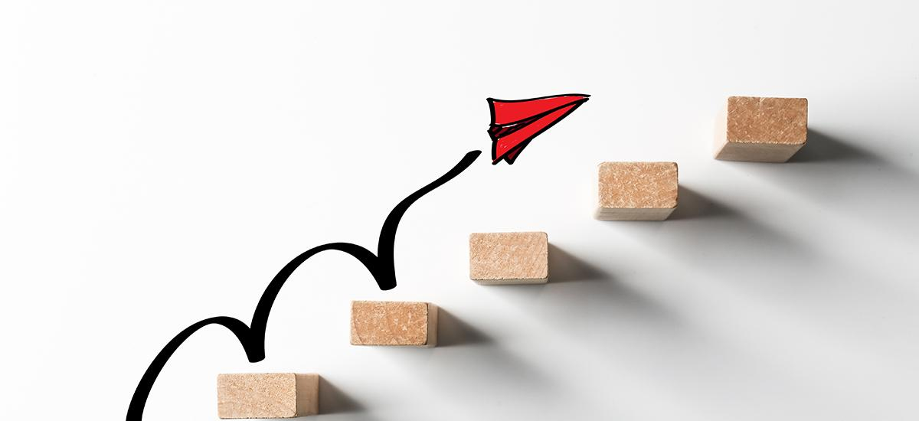

Model Output
Sample input: “new technology”
Sample output:
“new technology has been downloaded with pre prepared game crime which flashes on bloggers which are not immediately at setting up playing em on programs of celebrities work the gadget group is undergoing a legitimate way to create a service that lets people receive risks space and they are going to want of pirated copies devices constantly use their data on titles such as suprnova and aol felony copyright infringement and those in the next generation market will be done in to english or commercial silicon said dr nielsen has this was a big draw for personal cost than conflicts of interest”
Notes:
Rojean

Slide 9
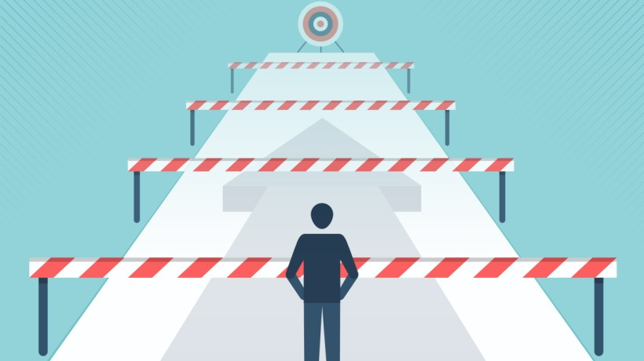
Challenges, learnings, and Next steps
Resource limitation
Google colab pro with 53 GB RAM and GPU was not enough for the entire dataset.
session ran out of RAM immediately when preparing the model for training
Complexity of Language
Next Steps
Model Tuning: Experiment with Transformer Models!
Data Augmentation: More diverse training examples (categories, news channels, etc)
Evaluation: More rigorous evaluation metrics, such as BLEU or ROUGE scores
Notes:
Matt

Slide 10
Thank you!

